Slide 1
Deployment strategy
ow

Slide 2
Definition
A deployment provides declarative update for pods and replica set.
In deployment, describe desired state. Deployment controller changes the actual state to the desired state
It maintains the replica set.
A Kubernetes Deployment is a declarative statement usually configured in a YAML file that defines the application lifecycle and how updates to that application should be applied.
When deploying your applications to a K8s cluster, your chosen deployment strategy will determine how those applications are updated to a newer version from an older one

Slide 3
Basic strategy
Some strategies will involve downtime. Some will introduce testing concepts and enable user analysis. There are two basic commonly used K8s deployment strategies:
Recreating
RollingUpdate

Slide 4
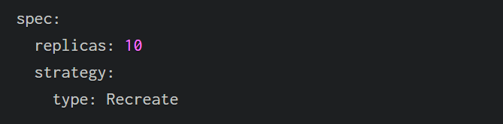
Recreate Deployment
Recreating deployment terminates all the pods and replaces them with the new version. This can be useful in situations where an old and new version of the application cannot run at the same time.
The amount of downtime incurred using this strategy will depend on how long the application takes to shut down and start back up.

Slide 5
Rolling
Rolling deployments are the default K8S offering designed to reduce downtime to the cluster. A rolling deployment replaces pods running the old version of the application with the new version without downtime.
The spec: -> strategy: section of the manifest file can be used to refine the deployment by making use of two optional parameters — maxSurge and maxUnavailable. Both can be specified using a percentage or absolute number. A percentage figure should be used when Horizontal Pod Autoscaling is used.
MaxSurge specifies the maximum number of pods the Deployment is allowed to create at one time.
MaxUnavailable specifies the maximum number of pods that are allowed to be unavailable during the rollout.

Slide 6
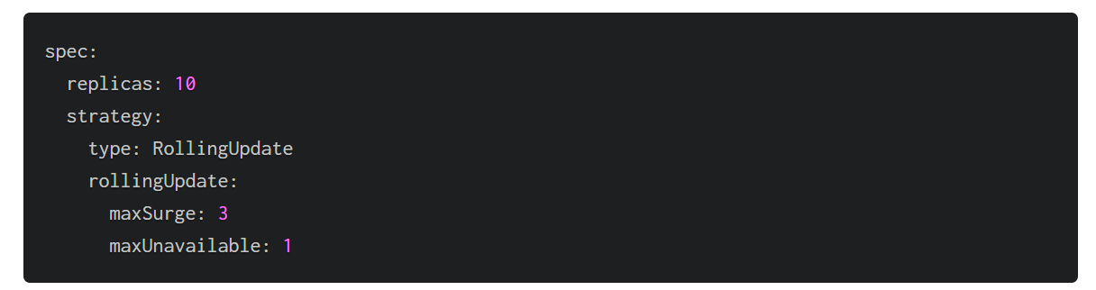
..

Slide 7
Blue/Green Deployment
The essence of this method lies in having two identical environments: one Blue and the other Green.
Blue Environment: This is the current production environment where the live traffic is directed. It runs the existing version of the application.
Green Environment: This is a clone of the Blue environment but with the new version of the application deployed. It is idle at first, with no live traffic directed to it.

Slide 8
How it works?
Preparation: Both Blue and Green environments are set up, with the Green environment mirroring the Blue in terms of infrastructure and configurations.
Deployment: The new version of the application is deployed to the Green environment. This deployment can be automated for efficiency.
Testing: Once the application is deployed in the Green environment, thorough testing is conducted. This phase is crucial to ensure that the new version is free of bugs and compatible with the production environment.

Slide 9
..
Routing Traffic: After successful testing, the traffic is gradually or completely shifted from the Blue environment to the Green environment. This can be done using load balancers or routing techniques to redirect user traffic.
Monitoring: Post-switch, continuous monitoring is essential to ensure that the Green environment operates smoothly and as expected.
Fallback Plan: In case of any issues, a quick rollback can be initiated to revert the traffic back to the Blue environment, minimizing the impact on end users.

Slide 10
canary
Canary deployment is a technique used to reduce the risk of introducing a new version of software into production by gradually rolling out the change to a small subset of users before making it available to the wider audience.
In Kub ernetes, canary deployments are achieved by running multiple versions of an application simultaneously and routing a portion of the traffic to the newer version while monitoring its performance

Slide 11
Why?
Risk Reduction: By exposing only a small percentage of users to the new version, you can mitigate the impact of potential bugs or issues before they affect the entire user base.
Early Feedback: Canary deployments allow you to gather feedback from real users in a production-like environment, enabling you to identify any problems early and make necessary adjustments.
Rollback Capability: If issues are detected during the canary phase, you can quickly roll back to the previous version without affecting all users.
Gradual Rollout: Gradually increasing the traffic to the new version gives you confidence in its stability and performance, ensuring a smooth transition.

Slide 12



